Slide 1

Dependent Types in Haskell
Stephanie Weirich
University of Pennsylvania https://github.com/sweirich/dth
@fancytypes

Slide 2
Dependent types in Haskell?
λ
Π
Notes:
I always wanted to have dependent types in Haskell, ever since I was a little girl
Spoiler alert. The answer is "NO"
But the long answer is yes.
Some of you may be wondering, What are Dependent Types?
This talk will give you some examples that you can play around with

Slide 3
Dependent Haskell
A set of language extensions for GHC that provides the ability to program as if the language had dependent types
{-# LANGUAGE DataKinds, TypeFamilies, PolyKinds, TypeInType, GADTs, RankNTypes, ScopedTypeVariables, TypeApplications, TemplateHaskell, UndecidableInstances, InstanceSigs, TypeSynonymInstances, TypeOperators, KindSignatures, MultiParamTypeClasses, FunctionalDependencies, TypeFamilyDependencies, AllowAmbiguousTypes, FlexibleContexts, FlexibleInstances #-}
Notes:
There is no fixed set of extensions that is called "Dependent Haskell"
What I refer to as "Dependent Haskell" is using these extension in a particular way inspired by dependently-typed programming
Why does GHC use language pragmas? Gives more flexibility. Good for PL research. Can do breaking changes. Can also see what programs use what features.
But DT is not just one language feature. Today I will analyze it by dividing it up into components

Slide 4
Why Dependent Types?
Domain-specific type checkers
Notes:
Much work in special purporse

Slide 5
Regular expression capture groups
Use regexps to recognize and parse a file path
"dth/regexp/Example.hs"
Return captured results in a dictionary
Basename "Example"
Extension "hs"
Directories in path "dth" "regexp"
Challenge: Type system verifies dictionary access
Notes:
Caveat: I'm not an expert at regular expressions.
(Note, usually capture groups capture at most one string. We're going to do better here.)

Slide 6
Example: a regexp for parsing file paths
Named capture groups marked by (?P<name>regexp)
/? -- optional leading "/"
((?P<dir>[^/]+)/)* -- any number of dirs
(?P<base>[^\./]+) -- basename
(?P<ext>\..*)? -- optional extension
Notes:
Note: only named capture groups, no numbers!
Make sure to say that for capture groups under a star, we are going to capture a list of results ---- most implementations return the last string only
Haskell doesn't have null. So optional strings have a different type.
Dependent type theory is easy compared to regular expressions.

Slide 7
Demo
path =
[re|/?((?P<dir>[^/]+)/)*(?P<base>[^\./]+)(?P<ext>\..*)?|]
filename =
"dth/regexp/Example.hs"

Slide 8
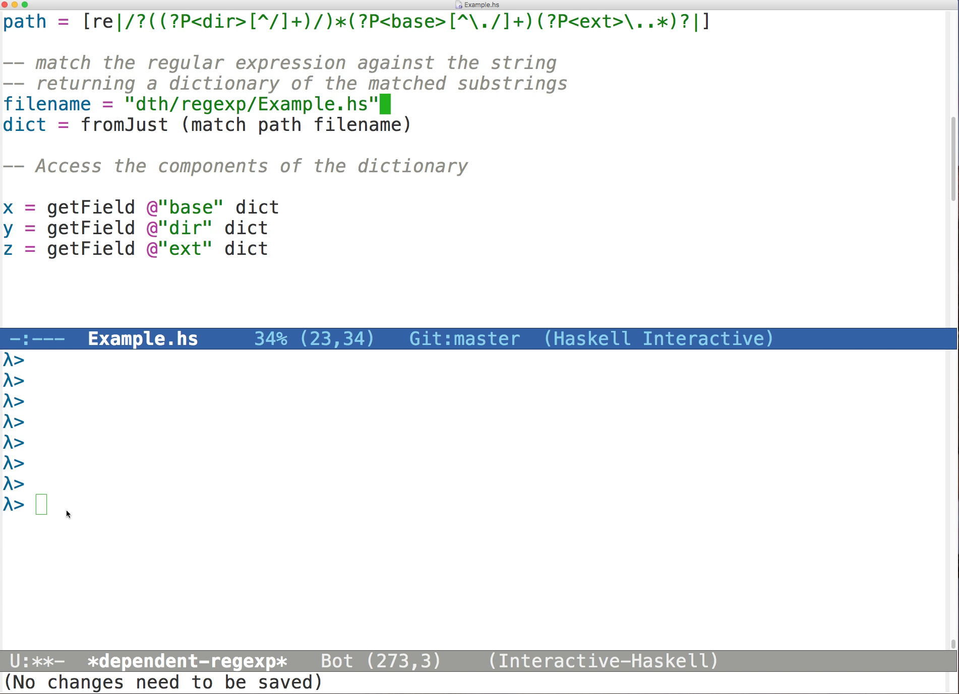

Slide 9
What are we asking for, when we ask for dependent types?

Slide 10
Four Capabilities of Dependent Type Systems
Type computation
Indexed types
Double-duty data
Equivalence proofs
Notes:
made it hard to read so that you'll pay attention!
Walk through the example looking a features individually.
Let's look at outcomes not mechanism. What abilities do dependently-typed languages provide?
When we say that we are using dependent types, we actually mean four different things. DTP requires all of these, more or less.

Slide 11
Type Computation
We can use the type system to implement a domain-specific compile-time analysis

Slide 12
How does this work?
λ> path = [re|/?((?P<dir>[^/]+)/)*(?P<base>[^/.]+)(?P<ext>\..*)?|]
λ> :t path
RE '['("base", Once), '("dir", Many), '("ext", Opt)]
Regular expression type includes a "Occurrence Map" computed by the type checker
data Occ = Once | Opt | Many
Notes:
Do this in the demo
Mention 's in promoted data constructors (and that they can sometimes be omitted.)
Mention that the type of d and path are inferred
The type checker must figure out what groups a regular expression could capture

Slide 13
How does this work?
1. Compile-time parsing
λ> path = [re|/?((?P<dir>[^/]+)/)*(?P<base>[^/.]+)(?P<ext>\..*)?|]
λ> :t path
RE '['("base", Once), '("dir", Many), '("ext", Opt)]
> path = ropt (rchar '/') `rseq` rstar (rmark @"dir" (rplus (rnot "/")) `rseq` rchar '/') `rseq` rmark @"base" (rplus (rnot "./")) `rseq` ropt (rmark @"ext" (rchar '.' `rseq` rstar rany))
Notes:
Do this in the demo
Mention 's in promoted data constructors (and that they can sometimes be omitted.)
Mention that the type of d and path are inferred

Slide 14
2. Type functions run by type checker
-- accepts empty string only, captures nothing
rempty :: RE '[]
-- accepts single char only, captures nothing
rchar :: Char -> RE '[]
-- alternative r₁|r₂
ralt :: RE s1 -> RE s2 -> RE (Alt s1 s2)
-- sequence r₁r₂
rseq :: RE s1 -> RE s2 -> RE (Merge s1 s2)
-- iteration r*
rstar :: RE s -> RE (Repeat s)
-- marked subexpression
rmark :: ∀k s. RE s -> RE (Merge (One k) s)
Notes:
Constructor types include functions "run" by type checker

Slide 15
Demo
r1 = rmark @"a" (rstar rany)
r2 = rmark @"b" rany
ex1 = r1 `rseq` r2

Slide 16
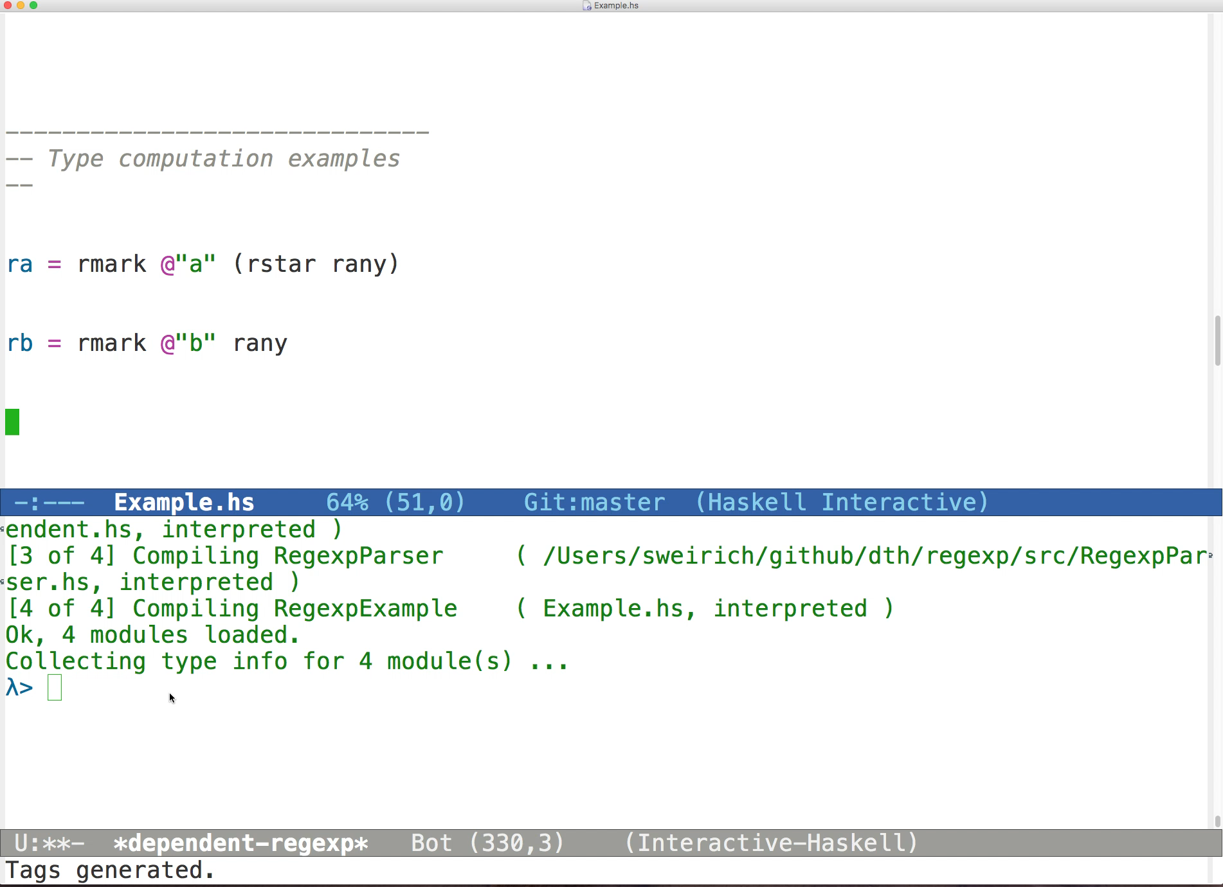

Slide 17
Indexed types
Type indices constrain values and guide computation

Slide 18
How does this work?
λ> :t dict
Dict '['("base", Once),'("dir", Many), '("ext", Opt)]
λ> getField @"ext" dict
Just "hs"
λ> getField @"f" dict
<interactive>:28:1: error:
• I couldn't find a capture group named 'f' in
{base, dir, ext}
Access resolved at compile time by type-level symbol
Custom error message

Slide 19
Types Constrain Data
λ> :t dict
Dict '['("base", Once),'("dir", Many),'("ext", Opt)]
Know dict must be a sequence of entries
E "Example" :> E ["dth","regexp"] :> E (Just "hs") :> Nil
Entries do not store keys
From type, know "base" first
Type computation resolves field access at compile time
Notes:
We know a lot from the type of the dictionary

Slide 20
Types Constrain Data with GADTs
λ> :t dict
Dict '['("base", Once),'("dir", Many),'("ext", Opt)]
Know dict must be a sequence of entries
E "Example" :> E ["dth","regexp"] :> E (Just "hs") :> Nil
data Dict :: OccMap -> Type where
Nil :: Dict '[]
(:>) :: Entry s o -> Dict tl -> Dict ('(s,o) : tl)
Notes:
We know a lot from the type of the dictionary

Slide 21
Types Constrain Data with Type Families
x :: Entry "ext" Opt
x = E (Just ".hs")
data Entry :: Symbol -> Occ -> Type where
E :: OccType o -> Entry k o
type family OccType (o :: Occ) :: Type where
OccType Once = String
OccType Opt = Maybe String
OccType Many = [String]

Slide 22
Double-duty data
We can use the same data in types and at runtime
Notes:
This is what most people think of when you say "Dependent types" i.e. types dependent on runtime values
This is also where Haskell "cheats"

Slide 23
How does this work?
dict :: Dict '['("base", Once),'("dir", Many),'("ext", Opt)]
dict =
E "Example" :> E ["dth", "regexp"] :> E (Just "hs") :> Nil
λ> print dict
{ base="Example", dir=["dth","regexp"], ext=Just ".hs" }
Notes:
Remember, the key and Occ are *not* present at runtime.

Slide 24
Dependent types: Π
showEntry :: Π k -> Π o -> Entry k o -> String
showEntry k o (E x) = showSym k ++ "=" ++ showData o x
showData :: Π o -> OccType o -> String
showData Once = showS
showData Opt = showMS
showData Many = showLS
showS :: String -> String
showMS :: Maybe String -> String
showLS :: [String] -> String

Slide 25
GHC's take: Singletons
showEntry :: Sing k -> Sing o -> Entry k o -> String
showEntry k o (E x) = showSym k ++ "=" ++ showData o x
showData :: Sing o -> OccType o -> String
showData SOnce = showS
showData SOpt = showMS
showData SMany = showLS
data instance Sing (o :: Occ) where
SOnce :: Sing Once
SOpt :: Sing Opt
SMany :: Sing Many

Slide 26
Equivalence proofs
Type checker must reason about program equivalence, and sometimes needs help

Slide 27
Working with type indices
data RE :: OccMap -> Type where
Rempty :: RE '[]
Ralt :: RE s1 -> RE s2 -> RE (Alt s1 s2)
Rseq :: RE s1 -> RE s2 -> RE (Merge s1 s2)
Rstar :: RE s -> RE (Repeat s)
…
rseq :: RE s1 -> RE s2 -> RE (Merge s1 s2)
rseq Rempty r2 = r2
rseq r1 Rempty = r1
rseq r1 r2 = Rseq r1 r2
-- Merge '[] s2 ~ s2

Slide 28
Working with type indices
type family Repeat (s :: OccMap) :: OccMap where
Repeat '[] = '[]
Repeat ((k,o) : t) = (k, Many) : Repeat t
rstar :: RE s -> RE (Repeat s)
rstar Rempty = Rempty -- need: Repeat '[] ~ '[]
rstar (Rstar r) = Rstar r
rstar r = Rstar r
-- oops!
• Could not deduce: Repeat s ~ s
from the context: s ~ Repeat s1
Need: Repeat (Repeat s1) ~ Repeat s1
Not true by definition. But provable!
Notes:
~ is equality in Haskell

Slide 29
Type classes to the rescue
class (Repeat (Repeat s) ~ Repeat s)
=> Wf (s :: OccMap)
instance Wf '[] -- base case
instance (Wf s) => Wf ('(n,o) : s) –- inductive step
rstar :: Wf s => RE s -> RE (Repeat s)
rstar Rempty = Rempty
rstar (Rstar r) = Rstar r
-- have: Repeat (Repeat s1) ~ Repeat s1
rstar r = Rstar r
Notes:
Define a predicate that
classifies OccMaps with the desired property.

Slide 30
Type classes to the rescue
class (Repeat (Repeat s) ~ Repeat s,
s ~ Alt s s,
Merge s (Repeat s) ~ Repeat s)
=> Wf (s :: OccMap)
instance Wf '[] -- base case
instance (Wf s) => Wf ('(n,o) : s) –- inductive step

Slide 31
So, is GHC dependently typed?

Slide 32
Four Capabilities of Dependent Type Systems
Type computation
Indexed types
Double-duty data
Equivalence proofs
BEST IN CLASS
TypeFamilies
DataKinds
TypeOperators
TypeApplications
MultiParamTypeClasses
FlexibleContexts
FlexibleInstances
TypeInType
UndecidableInstances
Notes:
BEST IN CLASS: Haskell includes many features not included in other dependently-typed languages
DataKinds, TypeFamilies, PolyKinds, TypeInType, GADTs, RankNTypes, ScopedTypeVariables, TypeApplications, TemplateHaskell, UndecidableInstances, InstanceSigs, TypeSynonymInstances, TypeOperators, KindSignatures, MultiParamTypeClasses, FunctionalDependencies, TypeFamilyDependencies, AllowAmbiguousTypes, FlexibleContexts, FlexibleInstances

Slide 33
Four Capabilities of Dependent Type Systems
Type computation
Indexed types
Double-duty data
Equivalence proofs
MATURE SUPPORT
GADTs
DataKinds
TypeInType
TypeLits
Notes:
Mature support: GADTs have been part of Haskell for over 10 years and interact well with HM type inference. Commonly used in practice.

Slide 34
Four Capabilities of Dependent Type Systems
Type computation
Indexed types
Double-duty data
Equivalence proofs
OK
GADTs
Singletons library
Current work: real Π type
Notes:
Need singletons to pattern match dependent data at runtime. Some parts supported by "singletons" library, but not a complete solution. Current research project: adding a real Π type to GHC.

Slide 35
Four Capabilities of Dependent Type Systems
Type computation
Indexed types
Double-duty data
Equivalence proofs
MANY EXCITING APPROACHES
MultiParamTypeClasses
FunctionalDependencies
Closed TypeFamilies
TypeFamilyDependencies
GADTs
Solver plugins
Notes:
Class system provides some proof automation not found in other languages, but has limitations. Explicit proof language provides weak reasoning. Room for external constraint solvers to increase reasoning power. No uniform technique.

Slide 36
Conclusion: Let's program with types!
Conclusion: GHC is in a fascinating part of the design space of dependently typed languages.
Notes:
Go to Jon Moore's talk!

Slide 37
https://github.com/sweirich/dth https://skillsmatter.com/conferences/10237-haskell-exchange-2018
Thanks to: Simon Peyton Jones, Richard Eisenberg, Dimitrios Vytiniotis, Vilhelm Sjöberg, Brent Yorgey, Chris Casinghino, Geoffrey Washburn, Iavor Diatchki, Conor McBride, Adam Gundry, Joachim Breitner, Julien Cretin, José Pedro Magalhães, Steve Zdancewic and NSF

Slide 38
fin
[code] https://github.com/sweirich/dth
[video] https://skillsmatter.com/conferences/10237-haskell-exchange-2018#skillscasts

